Slide 1
Statistical modelling
Yael Flax

Slide 2
project flow and steps
DATA API REQUESTS
PARSING /EXTRACTING FROM JSON
EDA
REGRESSION MODEL
INTERPRET MODEL

Slide 3

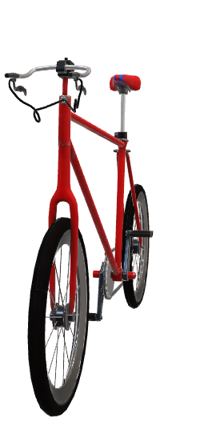
EDA
ASK = identify problem and define hypothesis:
can we ensure more bikes are being used ? relationship b/w station’s distance to a restaurant and the number of bikes used? Relationship b/w various features and available bikes?
2)COLLECT DATA = make API requests
3)CLEAN – for duplicate stations, restaurant names (x remove bec. station density), outliers .
4) ANALYZE – visualize features see if relationship between features and available bikes
univariate analysis – finding qualities of individual features such as mean , median bike availability , distance .
Bivariate analysis –testing relationship between features & bike usage ie. scatter plots

Slide 4
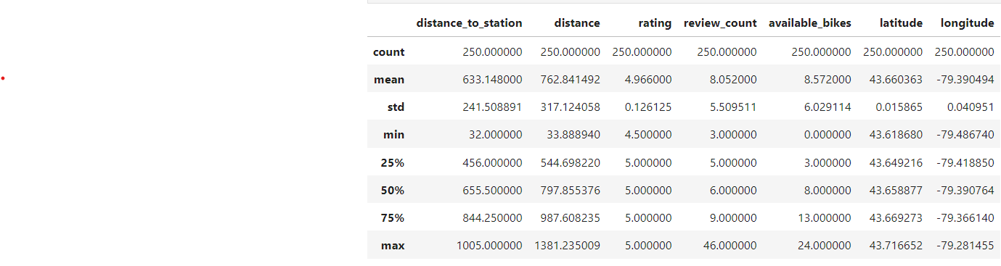
UNIVARIATE ANALYSIS
Descriptive Statistics for yelp + fsq (merged) df
Note: 8.57 avg available bikes, avg station latitude and long – most bike stations are in the same area

Slide 5
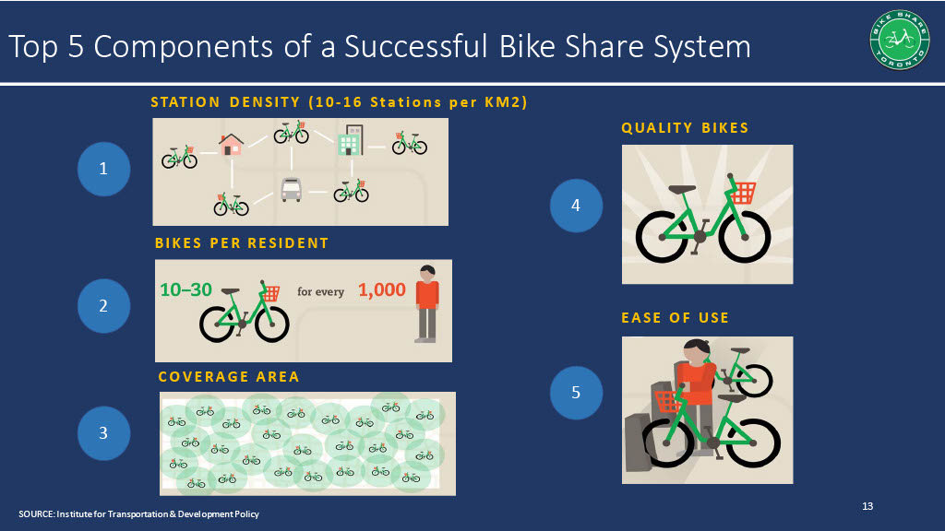
Based on the data provided by the city of Toronto, bike stations are strategically positioned in locations that intentionally have overlapping coverage.

Slide 6
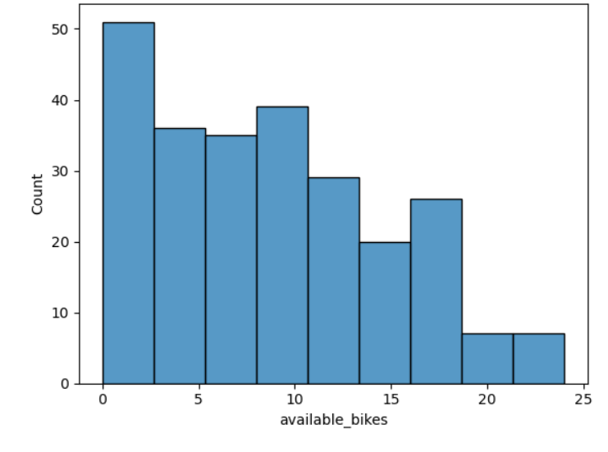
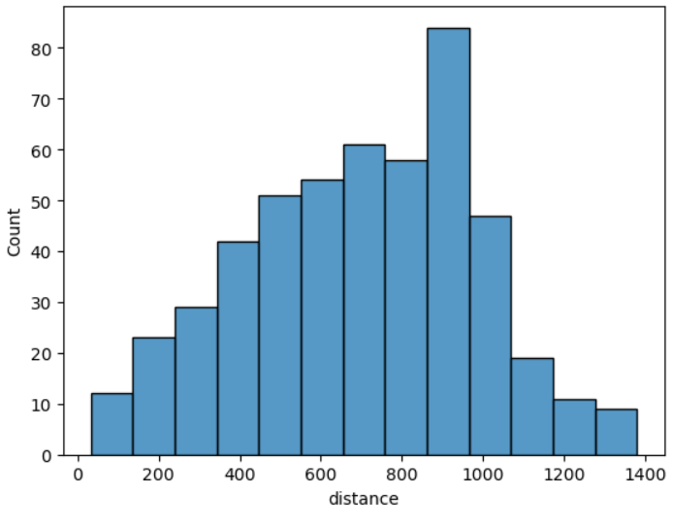
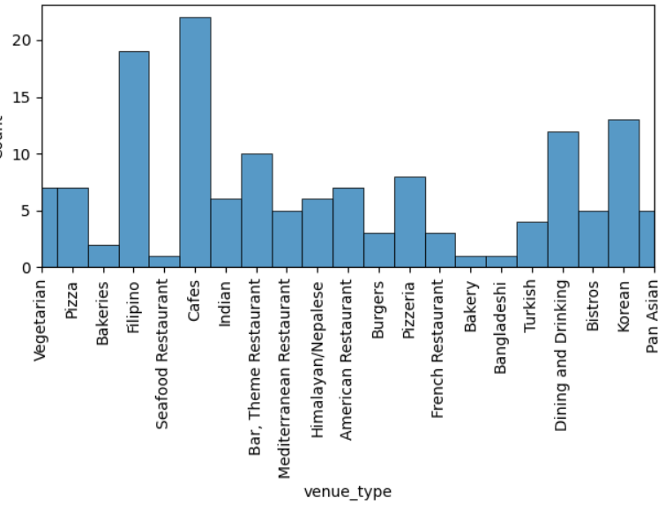
EDA: CheckING for normality & SKewdness of characteristics
# of available bikes distribution –skewed to the left
Normal distribution for distance except for outlier distance of ~900m
Non-normal distribution for venue types
Outlier = x remove bec. can be explained yelp Api request = highest rated restaurant per station with the radius 1000 as a gauge but not as a strict limit
Its true so x remove, request more data for more balance

Slide 7
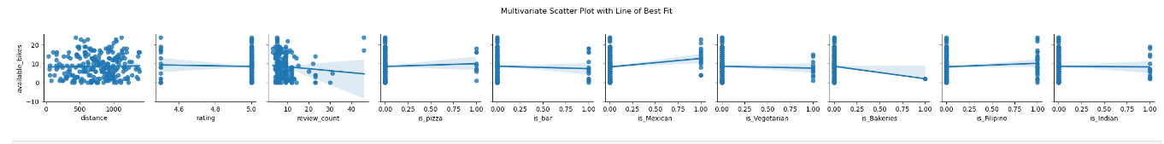
Visualization for regression model WITH Multivariate features vs available bikes
visual EDAnalysis : there does not seem to be a relationship between distance, rating , review_count, is_pizza,is_bar, is_Mexican, is_Vegetarian, is_Filipino,is_Indian respectively and available bikes

Slide 8



H(o): there is no relationship b/w features and available bikes H(1): there is a relationship b/w features and available bikes
P-val:for most features is above %5 – insignificant
&
Adjusted R^2 : is low – not fitted

Slide 9
linear regression interpretation
Fail to reject null hypothesis because p-vals > .05
Is_Mexican : p-value ~ .02 , significant
Adjusted R Squared < .05 , unfitting , variables explain ~ %4.4 of variance in available bikes
is_Mexican: For every one unit increase in the presence of a Mexican venue, there is an estimated increase of 4.6633 units in the available bikes.
is_Bakeries: For every one unit increase in the presence of a bakery venue, there is an estimated decrease of 8.8171 units in the available bikes.

Slide 10

CLASSIFICATION/ logistic regression Idea
Same x and y values but see if features can predict if available bikes will be in the null category or not
- Will convert this into a classification model

Slide 11
If I had more time :
Parse through the data and extract greater detail in order to perform deeper more robust analysis – get more than one restaurant per station so regression model can be well trained
diagnostic tests to test for linearity , normality of each feature and residuals before performing regression test. After I would test for homoscedasticity to see if variance of residuals is constant
MORE DATA!!!
Request APIs /get data for other characteristics around each bike station like demographics (ie,avg. age , income, occupation in order to discover dif. relationships these factors could have

Slide 12
THANK YOU

